Slide 1
What Makes my Glass of Wine so Tasty?
BANA7047-002-Group 9
Ashwita Saxena
Bharath Vattikuti
Mark McNall
Xi Ru

Slide 2
Outline
Motivations
Model Building
Model Comparison
Reference

Slide 3

Motivations
4898 Observations & 12 Variables
Physico-chemical constituents of the wines (11)
Sensory wine quality (1)
Level 0 to 10
To identify key factors that lead to greater white wine quality
Create predictive models using ordinal response
Good (7-10)
Okay (5-6)
Bad (0-4)
https://archive.ics.uci.edu/ml/datasets/wine+quality

Slide 4
Model Building
Ordinal Logistic Regression (POLR)
Classification Tree (CART)
Random Forest
Neural Network
Generalized Additive Model (GAM)
Gradient Boosting Machine (GBM)

Slide 5
Ordinal Logistic Regression
Variable | Value | ST Error | P-value | Odds Ratio
fixed.acidity | -0.10719 | 0.055723 | 5.44E-02 | 0.8983
volatile.acidity | -4.44449 | 0.429066 | 3.83E-25 | 0.0117
citric.acid | -0.10805 | 0.371709 | 7.71E-01 | 0.8975
residual.sugar | 0.056997 | 0.00956 | 2.50E-09 | 1.0586
chlorides | -6.3625 | 2.029921 | 1.72E-03 | 0.0017
free.sulfur.dioxide | 0.0175 | 0.003141 | 2.53E-08 | 1.0176
total.sulfur.dioxide | -0.0021 | 0.001397 | 1.34E-01 | 0.9979
pH | 0.307394 | 0.300784 | 3.07E-01 | 1.3598
sulphates | 1.310808 | 0.33822 | 1.06E-04 | 3.7091
alcohol | 0.900561 | 0.043663 | 1.62E-94 | 2.4609
0|1 | 5.605796 | 1.28094 | 1.21E-05
1|2 | 11.09438 | 1.296973 | 1.19E-17
Predicted
 | 0 | 1 | 2
0 | 4 | 140 | 2
1 | 0 | 2782 | 142
2 | 0 | 636 | 212
True
In-sample MR | Out-of-Sample MR
0.2348 | 0.2398

Slide 6
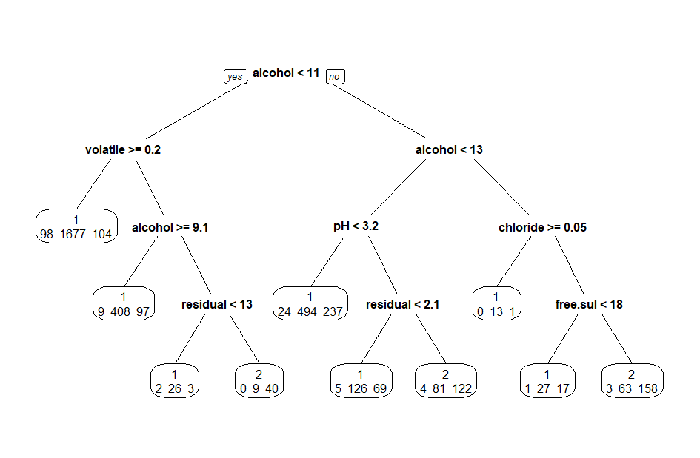
Classification Tree
Predicted
 | 0 | 1 | 2
0 | 0 | 139 | 7
1 | 0 | 2771 | 153
2 | 0 | 528 | 320
True
In-sample MR | Out-of-Sample MR
0.2111 | 0.2449

Slide 7
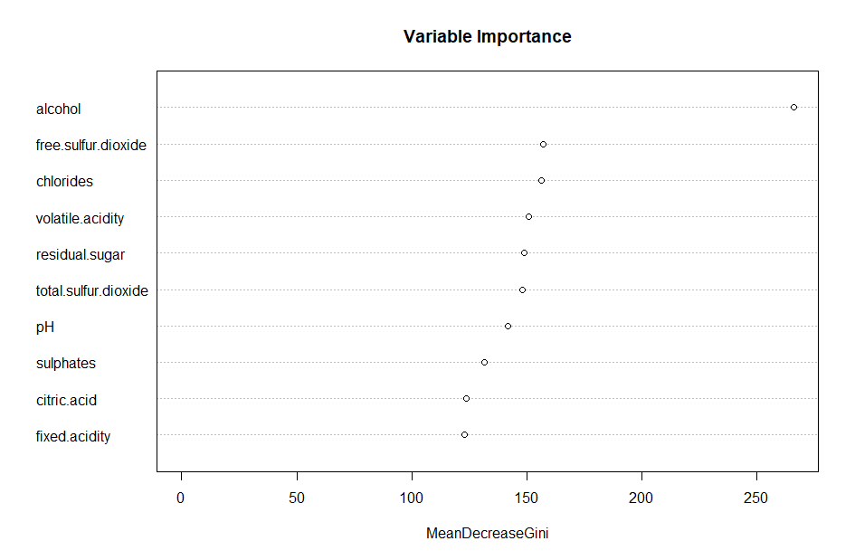
Random Forest
Predicted
 | 0 | 1 | 2
0 | 19 | 126 | 1
1 | 6 | 2796 | 122
2 | 0 | 349 | 499
True
In-sample MR | Out-of-Sample MR
0.1542 | 0.1449

Slide 8
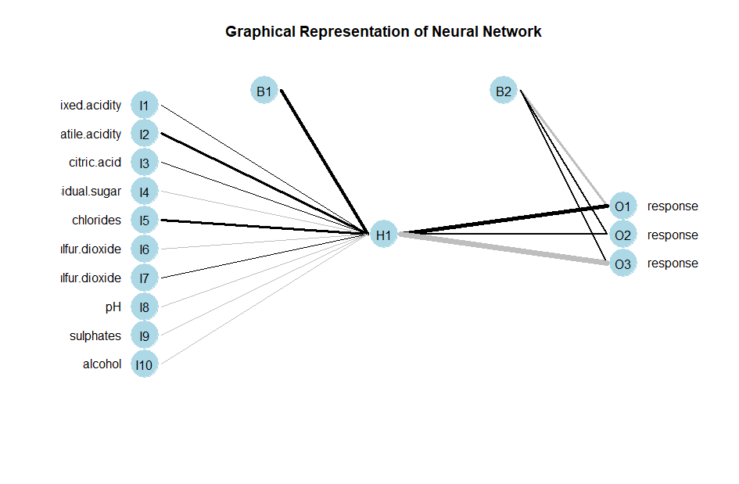
Neural Network
Predicted
 | 0 | 1 | 2
0 | 0 | 145 | 1
1 | 0 | 2801 | 123
2 | 0 | 646 | 202
True
In-sample MR | Out-of-Sample MR
0.2335 | 0.2327

Slide 9
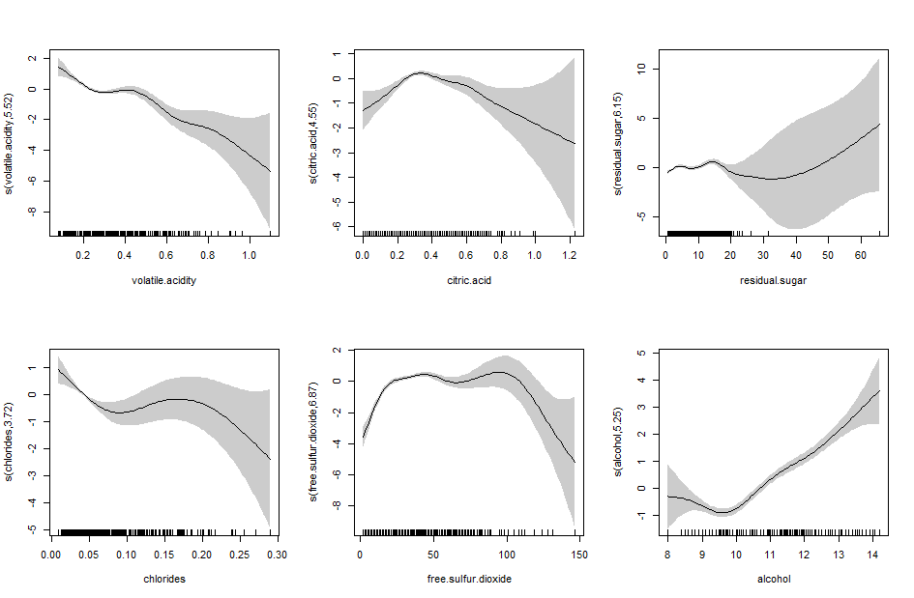
Generalized Additive Model
Predicted
 | 0 | 1 | 2
0 | 11 | 133 | 2
1 | 10 | 2732 | 182
2 | 0 | 567 | 281
True
In-sample MR | Out-of-Sample MR
0.2282 | 0.2306

Slide 10
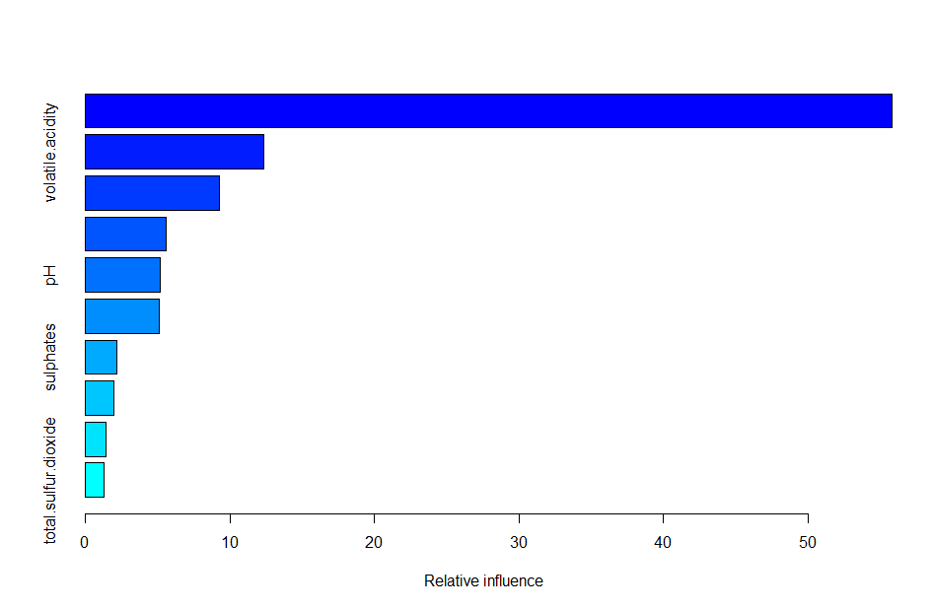
Gradient Boosting
Predicted
 | 0 | 1 | 2
0 | 5 | 139 | 2
1 | 1 | 2826 | 97
2 | 0 | 580 | 268
True
alcohol
volatile.acidity
free.sulfur.dioxide
citric.acid
residual.sugar
sulphates
fixed.acidity
pH
total.sulfur.dioxide
chlorides
In-sample MR | Out-of-Sample MR
0.2090 | 0.2276

Slide 11
Model Comparison
 | In-sample MR | Out-of-Sample MR
OLR | 0.2348 | 0.2398
CART | 0.2111 | 0.2449
Random Forest | 0.1542 | 0.1449
Neural Network | 0.2335 | 0.2327
GAM | 0.2282 | 0.2306
GBM | 0.2090 | 0.2276
Conclusion
Random Forest has best prediction in term of MR
Alcohol content is most important predictor of wine quality

Slide 12
References
P. Cortez, A. Cerdeira, F. Almeida, T. Matos and J. Reis. Modeling wine preferences by data mining from physicochemical properties. In Decision Support Systems, Elsevier, 47(4):547-553, 2009.
https://archive.ics.uci.edu/ml/datasets/wine+quality
https://www.kaggle.com/uciml/red-wine-quality-cortez-et-al-2009

